Slide 1
4-BIT ARITHMETIC
LOGIC UNIT (ALU)
A, B, Opcode
ALU
4-bit
Design, Verilog implementation and simulation
Result + Flags
Pham Quoc Viet | SE204606
Project Presentation
4-bit ALU | Pham Quoc Viet | SE204606
01

Slide 2
1. Project Overview
PART 1
What is an ALU?
Our project
Main output
An ALU is a digital circuit.
It performs math and logic operations.
A 4-bit ALU takes two 4-bit inputs: A and B.
The opcode selects the operation.
The ALU gives an 8-bit result and status flags, such as carry, zero and overflow.
Main goal
Build the ALU, connect its modules, and check the results in Vivado simulation.
4-bit ALU | Pham Quoc Viet | SE204606
02

Slide 3
2. Inputs and Outputs
PART 1
Signal | Width | Simple meaning
A, B | 4 bits each | Two input numbers
Opcode | 4 bits | Selects the operation
clk, rst, start | 1 bit each | Clock, reset and start control
result | 8 bits | Operation result
carry, zero, overflow, negative | 1 bit each | Status flags
busy, done, div_by_zero | 1 bit each | Multiply/divide status
Example: A = 0111 and B = 0001 means 7 and 1 in binary.
4-bit ALU | Pham Quoc Viet | SE204606
03

Slide 4
3. How the ALU Works
PART 1
A and B go to the function blocks. The opcode tells the ALU what to do.
Arithmetic
ADD / SUB
A, B
Result
Multiply /
Divide
Logic
AND / OR / XOR / NOT
Result MUX
Opcode
Flag Unit
Shift
SHL / SHR
4-bit ALU | Pham Quoc Viet | SE204606
04

Slide 5
4. Opcode Table
PART 1
Opcode | Operation | Meaning
0000 | ADD | A + B
0001 | SUB | A − B
0010 | AND | A AND B
0011 | OR | A OR B
0100 | XOR | A XOR B
0101 | NOT A | Invert A
0110 | SHL | Shift A left
0111 | SHR | Shift A right
1000 | MUL | A × B
1001 | DIV | A ÷ B
DIV output: result[7:4] = remainder | result[3:0] = quotient
4-bit ALU | Pham Quoc Viet | SE204606
05

Slide 6
5. Arithmetic Operations
PART 2
ADD — Opcode 0000
SUB — Opcode 0001
Example:
A = 0011 (3)
B = 0010 (2)
Result = 0101 (5)
Example:
A = 0101 (5)
B = 0010 (2)
Result = 0011 (3)
The same adder/subtractor block is used. A control signal selects add or subtract.
The carry and overflow flags help describe the arithmetic result.
4-bit ALU | Pham Quoc Viet | SE204606
06

Slide 7
6. Logic and Shift Operations
PART 2
Logic block
Shift block
AND: output bit is 1 when both input bits are 1.
OR: output bit is 1 when at least one input bit is 1.
XOR: output bit is 1 when the input bits are different.
NOT A: changes every bit of A.
SHL: move bits of A to the left.
SHR: move bits of A to the right.
Example:
A = 0011
SHL → 0110
SHR → 0001
These operations work on 4-bit values.
4-bit ALU | Pham Quoc Viet | SE204606
07

Slide 8
7. Multiply and Divide
PART 2
MUL — Opcode 1000
DIV — Opcode 1001
The multiply/divide unit calculates A × B.
Example: 0011 × 0010 = 00000110
(3 × 2 = 6)
The unit calculates A ÷ B.
Example: 0111 ÷ 0010 = quotient 0011, remainder 0001.
Control signals
start begins the operation. busy shows that it is working. done shows that it has finished. div_by_zero reports division by zero.
4-bit ALU | Pham Quoc Viet | SE204606
08

Slide 9
8. Status Flags
PART 2
Flag | Simple meaning
carry | A carry bit from an arithmetic operation
zero | The result is zero
overflow | The signed result is outside the 4-bit range
negative | The result has its sign bit set
div_by_zero | Division by zero was detected
busy / done | The multiply/divide unit is working / finished
Example of signed overflow: 0111 + 0001 = 1000. In signed 4-bit numbers, 7 + 1 is outside the range −8 to +7.
4-bit ALU | Pham Quoc Viet | SE204606
09

Slide 10
9. Verilog Design Structure
PART 3
The top-level module is alu_4bit. It connects the smaller modules.
control_unit
adder_subtractor_4bit
Reads opcode and creates control signals
Performs ADD and SUB
logic_unit_4bit
shifter_4bit
Performs logic operations
Performs left and right shifts
muldiv_unit
result_mux
Performs multiply and divide
Selects the final result
flag_unit
Creates status flags
4-bit ALU | Pham Quoc Viet | SE204606
10

Slide 11
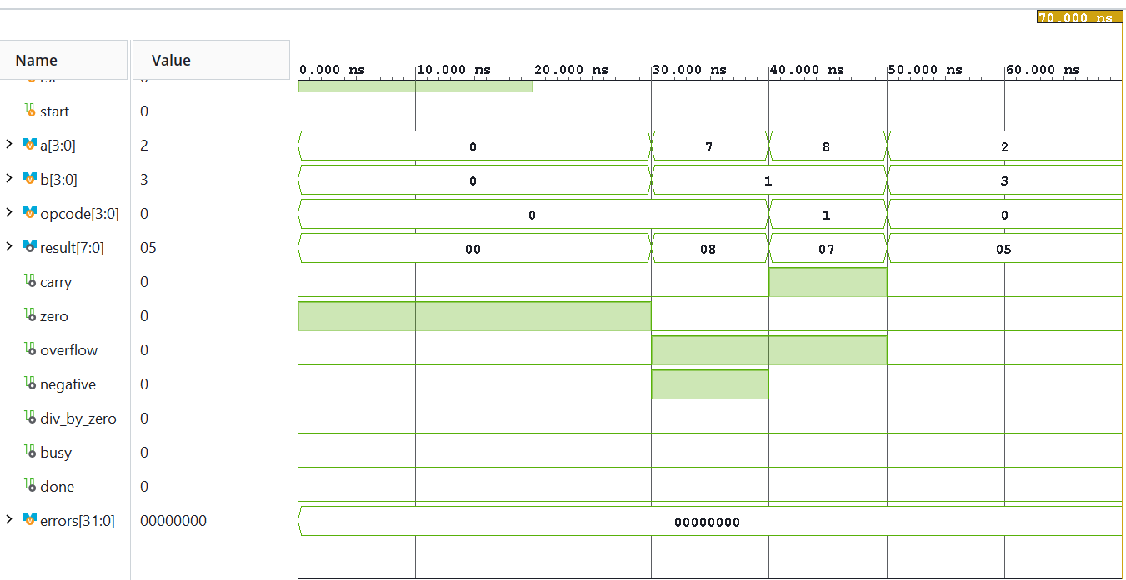
10. Functional Simulation — Normal Operation
PART 3
Test vector
opcode = 0000 (ADD)
A = 2, B = 3
Expected result
2 + 3 = 5
result = 8'h05
Observed flags
carry = 0, zero = 0
negative = 0, overflow = 0
Waveform: ADD, A = 2, B = 3
11

Slide 12
10. Simulation: Normal Testbench
PART 3
This test checks a normal ADD operation. The testbench applies inputs, waits, and checks the result.
Test | A | B | Opcode | Expected result | Overflow
ADD overflow | 0111 | 0001 | 0000 | 00001000 | 1
SUB overflow | 1000 | 0001 | 0001 | 00000111* | 1
Normal ADD | 0010 | 0011 | 0000 | 00000101 | 0
Expected: 2 + 3 = 5. The ALU should return 00000101, with overflow = 0.
ADD WAVEFORM
Vivado waveform — show A, B, opcode, result and flags
Insert the real waveform from your successful testbench run.
4-bit ALU | Pham Quoc Viet | SE204606
12

Slide 13
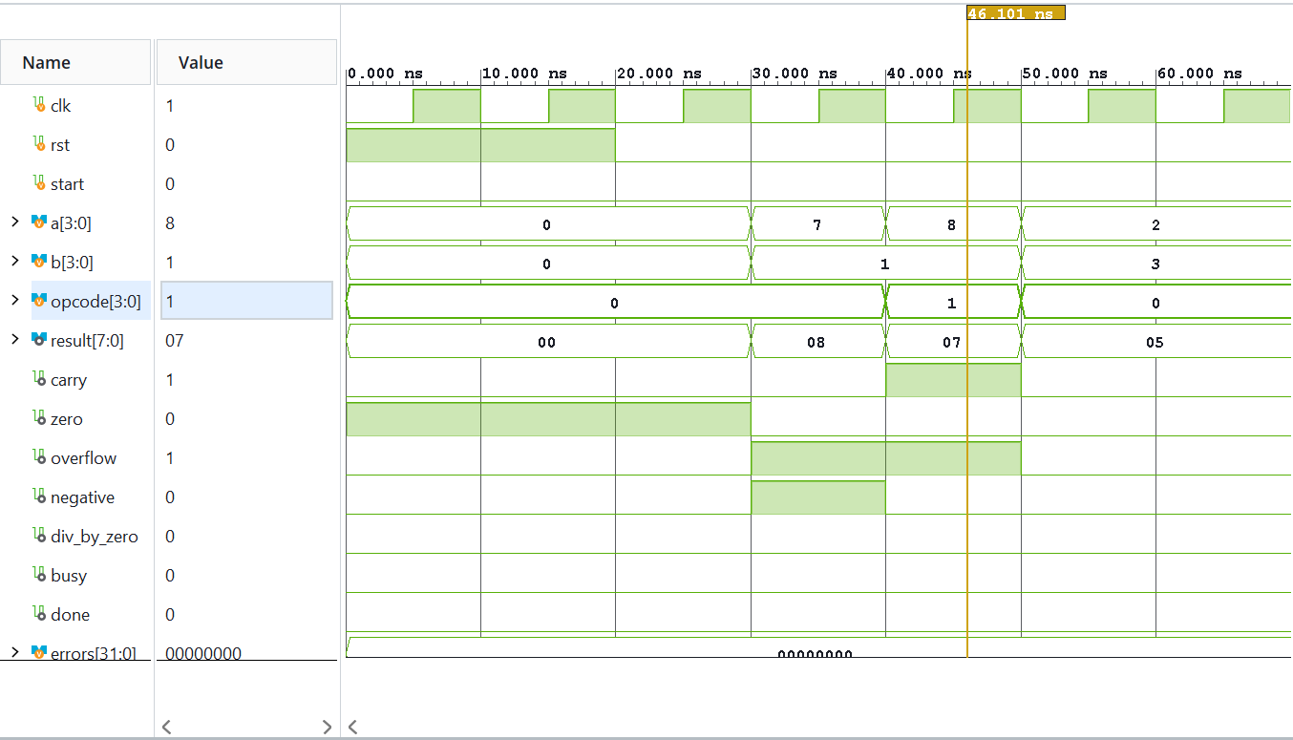
11. Functional Simulation — Signed Overflow
PART 3
Test vector
opcode = 0001 (SUB)
A = 4'b1000, B = 4'b0001
4-bit result
8 − 1 = 7
result = 8'h07
Overflow observed
overflow = 1
The signed operation −8 − 1 is outside the 4-bit signed range (−8 to +7).
Waveform: SUB, A = 8, B = 1
13

Slide 14
11. Simulation: Overflow Test
PART 3
Testbench input
Expected result
Signal | Value | Meaning
A | 0111 | 7
B | 0001 | 1
opcode | 0000 | ADD
0111 + 0001 = 1000
Result = 00001000
overflow = 1
In signed 4-bit numbers, 7 + 1 is outside the range −8 to +7.
4-bit ALU | Pham Quoc Viet | SE204606
14

Slide 15
11. Vivado Design Flow
PART 3
1
Write Verilog
2
Add testbench
3
Run simulation
4
Elaborate design
5
Run synthesis
6
Check reports
Screenshots to include
• Sources: show the project files.
• Elaborated schematic: show module connections.
• Waveform: show test results.
• Utilization report: show hardware resources.
4-bit ALU | Pham Quoc Viet | SE204606
15

Slide 16
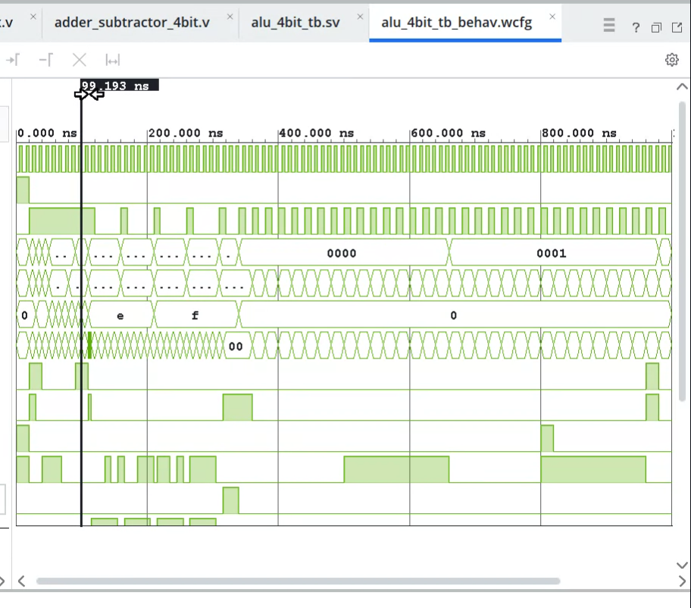
12. Testbench Coverage
• Clock and reset are applied.
• Inputs and opcode change during simulation.
• Result and flags are observed over time.
• Use the self-checking testbench output to confirm PASS/FAIL.
Testbench waveform with changing inputs and opcode
8

